Slide 1


Machine Learning
A
PRACTICAL Approach
Day 1

Slide 2

Machine Learning PRACTICAL Workshop
Lalit Kumar | Speaker
Prof. Kapil Mundada | Coordinator
Aniket Patil | Organiser

Slide 3
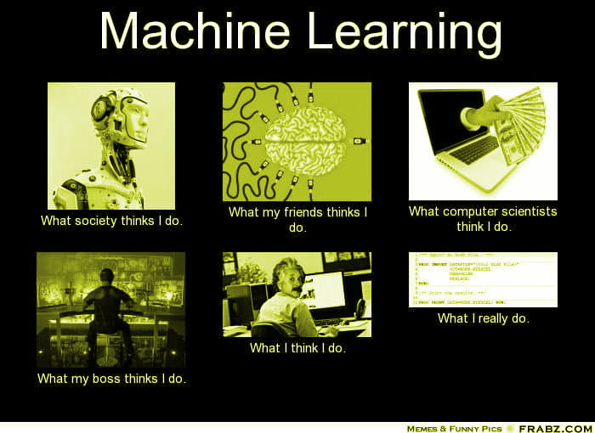
What is Machine Learning?

Slide 4
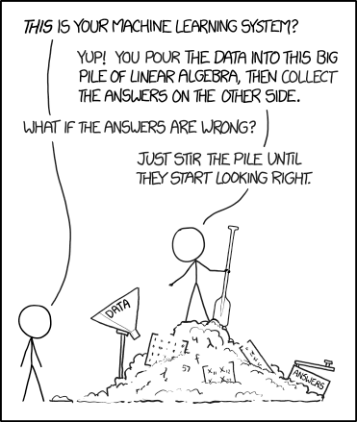
What is Machine Learning?
The name machine learning was coined in 1959 by Arthur Samuel. Tom M. Mitchell provided a widely quoted, more formal definition of the algorithms studied in the machine learning field:
“A computer program is said to learn from experience E with respect to some class of tasks T and performance measure P if its performance at tasks in T, as measured by P, improves with experience E."
Source: xkcd.com

Slide 5
Why Machine Learning?
Vast applications - Can be applied to any field possible
Reduce complexity - No more writing code to handle all the cases
Better Generalisation - Things work without taking into consideration all possible scenarios
Finding hidden gems - Explore hidden features in the data that might be impossible for humans to find

Slide 6
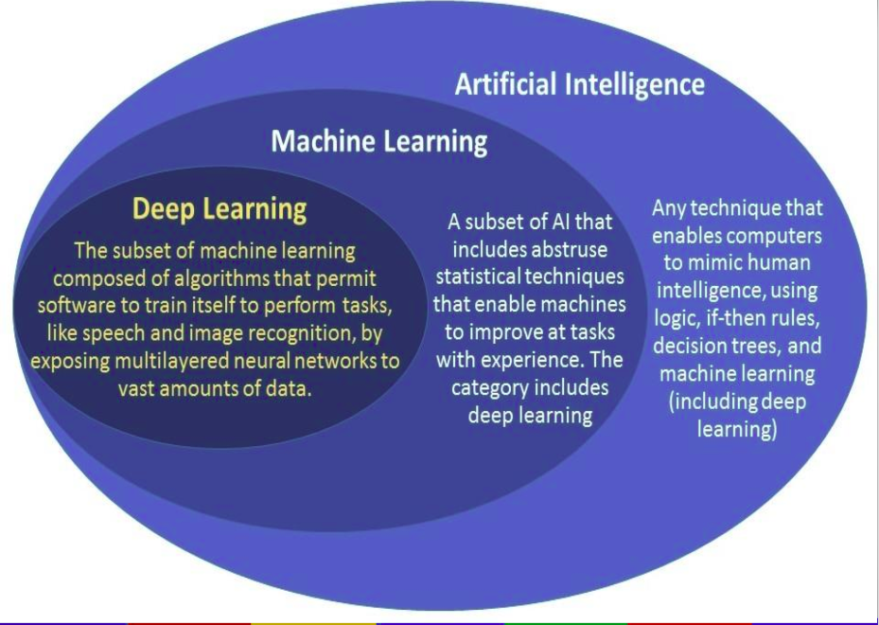
Machine Learning vs Deep Learning vs AI

Slide 7
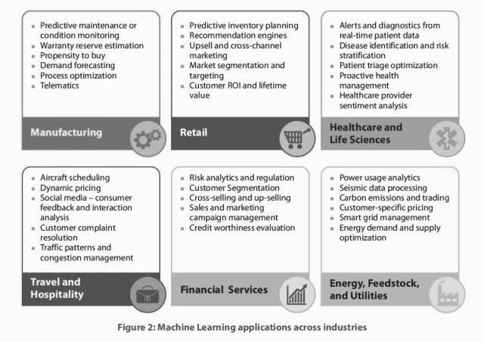
Applications of Machine Learning

Slide 8
Structure of the workshop - Day 1
Basic Terminologies
Types of Machine Learning
Jupyter Notebook ( Intro to Google Colab, nteract )
Pandas, Numpy
Data Visualisation with matplotlib
A brief intro to Python IDEs like Spyder, PyCharm etc

Slide 9
Structure of the workshop - Day 2
Decision Trees
Random Forests
Linear Regression
Logistic Regression
K Means Clustering
K Nearest Neighbor
Support Vector Machines
Things to do after the workshop.

Slide 10
Basic Terminologies
Day 1
A feature is an input variable generally denoted by X.
Examples of features for a spam detector can be:
Words in the email text
Sender’s address
Time of the day the email was sent
A Label is the output variable, denoted by Y. The label is the thing that we want to predict. For example, whether an email is spam or not.

Slide 11
Basic Terminologies
Day 1
The data that we have sometimes can be labelled or unlabelled.
A model describes the relationship between the features and labels and is the core of ML. We will create different models that can understand relationships between different features and predict correct labels.

Slide 12
Basic Terminologies
Day 1
Splitting Dataset:
A dataset is generally split into three subsets - train, validation and test set. The model is built using train set, once we are happy with the model, we check it on the validation set. If the results are not upto mark, then the above process is repeated. For a final check, the data is tested on the test set to make sure that our models generalize.

Slide 13
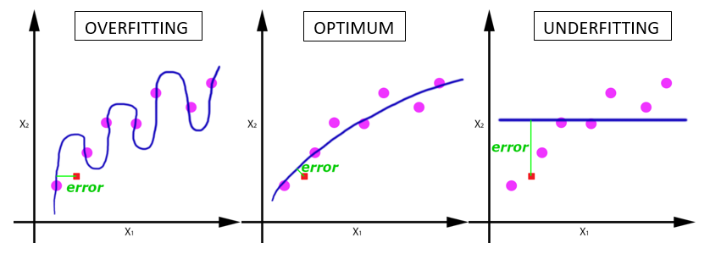
Basic Terminologies
Day 1
A model overfits when it just learns the train set and is not able to generalize.

Slide 14
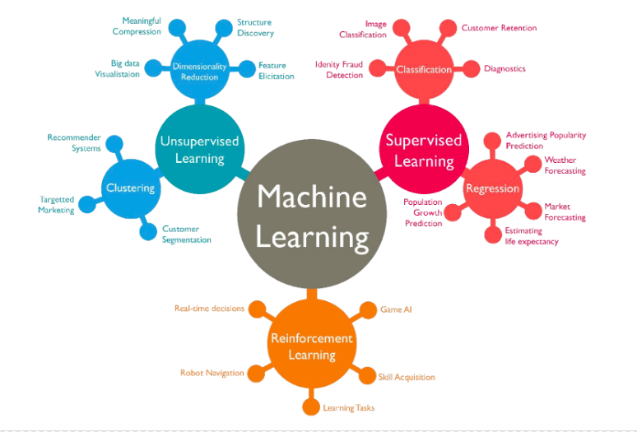
Types of Machine Learning

Slide 15
Supervised Learning
Day 1
Supervised learning deal with creating models based on labelled data. The dataset consists of a list of features for each data point and a label associated with it. The aim of supervised learning is to create models that can be used to predict labels from never-before-seen data.
This is similar to humans learning from teachers.
Types -
Regression (Continuous Prediction *)
Classification (Discrete Prediction *)

Slide 16
Unsupervised Learning
Day 1
Unsupervised learning deals with data without labels. The aim is to infer patterns from the data and cluster them rather than predict a label value.
This is similar to humans learning on their own.
Types:
Clustering
Dimensionality Reduction

Slide 17

Reinforcement Learning
Day 1
It is a reward based training approach in which the model interacts with the environment to gather feedback for its actions. Recent research has produced models that do can work from internal rewards as well, just like humans learn from their internal motivation.
Reinforcement learning along with deep learning aims to create models that specialize in general tasks.
Example Agents: OpenAI Five, AlphaGo Zero

Slide 18
Prerequisites for this Workshop
Prerequisites for Theoretical Machine Learning
Prerequisites for Practical Machine Learning
Basic understanding of Python
Linear Algebra
Matrix Computations
Probabilities
Programming Language like C++/Java/Python etc. We will use Python.
A good understanding of Mathematics is recommended but not required.

Slide 19
Intro to Jupyter Notebook
Day 1
Jupyter notebook is a great tool to prototype and create your models
Online platforms like Google Colab can be used to collaborate on notebooks
You can also use desktop applications like nteract

Slide 20
Pandas and Numpy
Day 1
Refer to corresponding notebooks

Slide 21
Data Visualisation
Day 1
Refer to corresponding notebooks

Slide 22
Python IDEs
Day 1
Spyder
PyCharm
Visual Studio Code
Python IDLE

Slide 23
Machine Learning
A
PRACTICAL Approach
Day 2

